Slide 1

Domain Training DDD (Banking) Event Driven Design (Theory)
Java Full Stack Program

Slide 2
Domain-Driven Design (DDD)
What is Domain ?
The word Domain used in context of software development refers to business.
In the process of application development, term domain logic or business logic is commonly used.
Basically, business logic is area of knowledge around which application logic revolves.
The business logic of an application is a set of rules and guidelines that explain how business object should interact with each other to process modeled data.

Slide 3
Definition of DDD?
Domain-Driven Design (DDD) is an approach to software development that focuses on modeling complex business domains to produce high-quality software that meets the needs of the business.
It is a way of thinking about software design that emphasizes the importance of understanding the business problem at hand and creating a model of that problem domain that can be used to guide the development process.

Slide 4
Strategic Design :
The strategic design tools help us to solve all problems that are related to software modeling.
It is a design approach that is similar to Object-oriented design where we are forced to think in terms of objects.
Herewith strategic design we are forced to think in terms of a context.
Context :
We can consider this an English word that refers to circumstances of an event, incident, statement, or idea, and in terms of which it’s meaning could be determined.
Apart from Context, Strategic design also talks about Model, Ubiquitous Language, and Bounded Context.
These are common terms used in strategic Design of Domain-Driven Design.
Let’s understand each one by one.

Slide 5
1. Model
It acts as a core logic and describes selected aspects of domain.
It is used to solve problems related to that business.
2. Ubiquitous Language
A common language used by all team members to connect all activities of team around domain model.
Consider it like using common verbs and nouns for classes, methods, services, and objects while talking with domain experts and team members.
3. Bounded Context
It refers to boundary conditions of context.
It is a description of a boundary and acts as a threshold within which, a particular domain model is defined and applicable.

Slide 6
Tactical Design :
Tactical design talks about implementation details i.e., modeling domain.
It generally takes care of components inside a bounded context.
We might have heard or used stuff like services, entities, repositories, and factories.
They have all coined and made popular by Domain-Driven design.
The tactical design process occurs during product development phase.
Let’s discuss some of important tactical design tools.
These tools are high-level concepts that can be used to create and modify domain models.

Slide 7
1. Entity
A programmer who has worked on Object-oriented principles might be aware of concepts called class and objects.
Here an entity is a class that has some properties.
The instance of these classes has a global identity and keeps same identity throughout lifespan.
Remember there can be a change in state of property but identity never changes.
In short, an entity implements some business logic and could be uniquely identified using an ID.
In context of programming, it generally persisted as a row in DB and it consists of value objects.

Slide 8
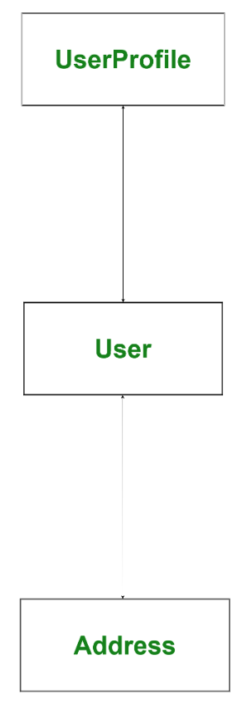
2. Value Objects –
These are immutable, light-weight objects that don’t have any identity.
Value objects reduce complexity by performing complex calculations,
isolating heavy computational logic from entities.
In the above image User is an entity and Address is a value
object, address can change many times but
identity of User never changes.
Whenever an Address gets change then a new
Address will be instantiated and assigned to User.

Slide 9
3. Services
A service is a stateless class that fits somewhere else other than an entity or value object.
In short, a service is a functionality that exists somewhere between entities and values objects but it is neither related to an entity nor values objects.
4. Aggregates
When we have bigger project, object graph becomes big, The bigger object graph harder it is to maintain it.
An aggregate is a collection of entities and values which come under a single transaction boundary.
Aggregates basically, control change and have a root entity called aggregate roots.
The root entity governs lifetime of other entities in aggregates.

Slide 10
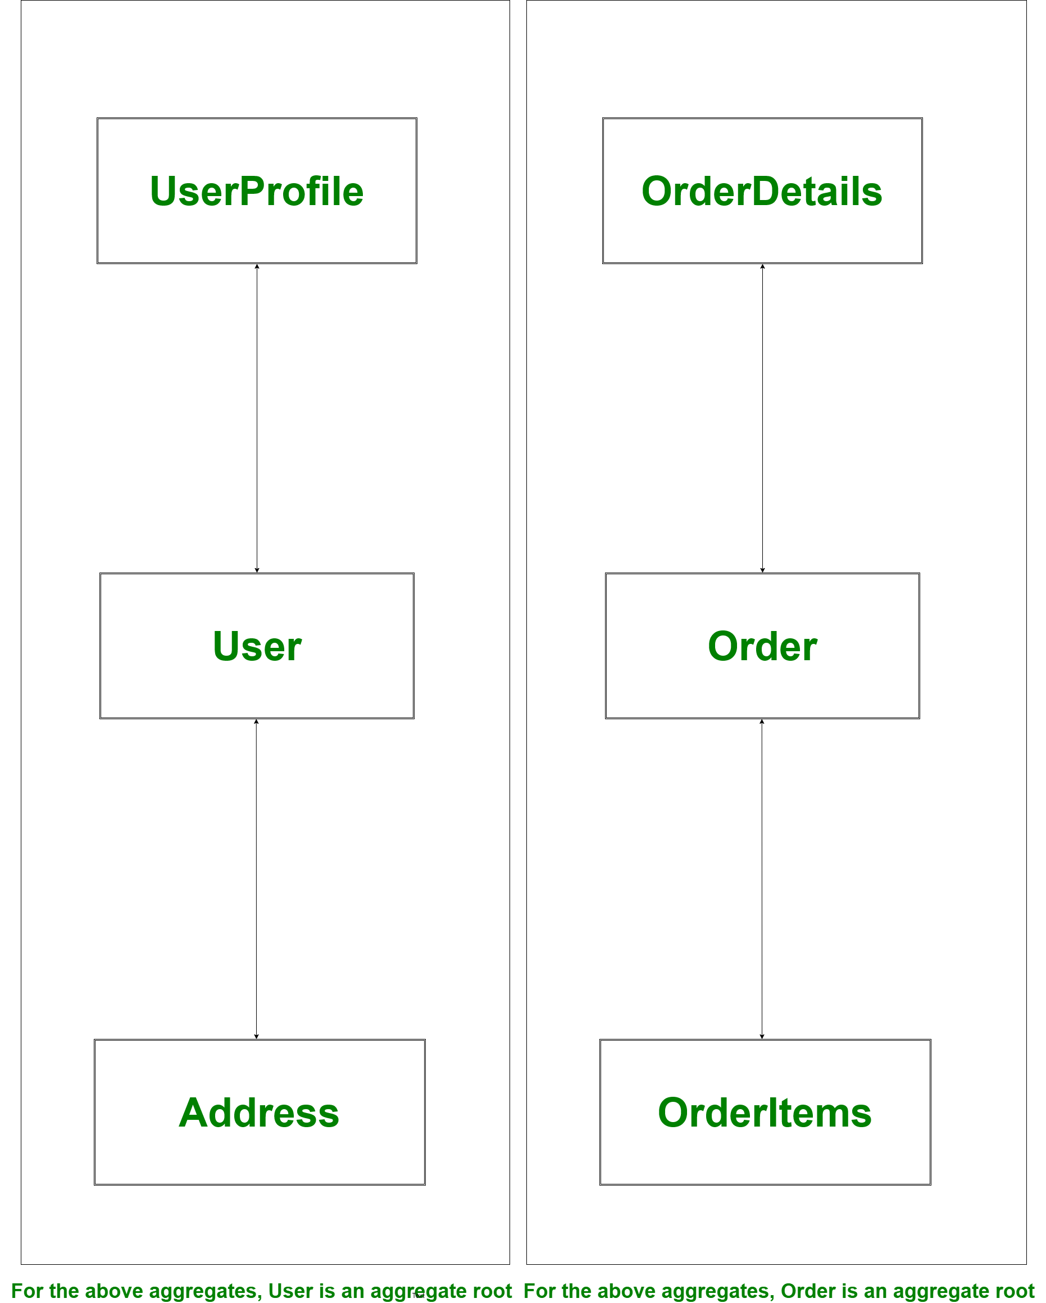

Slide 11
In the above example if root entity User or Order gets deleted other entities associated with the root entity will be of no use and this associated information will also be deleted.
That means an aggregate is always consistent in nature and this done with help of domain events.
Domain events are generated to ensure eventual consistency.
In the above example if address of User has been changed then it has to be reflected in Order as well.
To do so we can fire a domain event from User to Order so that Order updates address so that we have eventual consistency and Order will be eventually consistent.

Slide 12
5. Factories and Repositories
Factories and Repositories are used to handle aggregate.
Factories help in managing beginning of lifecycle of aggregates whereas Repositories help in managing middle and end of lifecycle of an aggregate.
Factories help in creating aggregates whereas Repositories help in persisting aggregates.
We should always create a repository per aggregate root but not for all entities.

Slide 13
Advantages of Domain-Driven Design :
It improves our craft.
It provides flexibility
It prefers domains over interface
It reduces communication gap between teams through Ubiquitous Language
Disadvantages of Domain-Driven Design :
It requires a professional who has strong domain expertise
It encourages team to follow iterative practices

Slide 14
Event Driven Design (Theory)
Event-Driven Architecture (EDA) :
Event-Driven Architecture is a software development approach in which services (operations) of the software are triggered by events.
And that is why this approach is known as Event-Driven Architecture.
Well, then what does an event mean? When a user takes an action in the application built using the EDA approach, a state change happens and a reaction is generated that is called an event.

Slide 15
Types of events in EDD
In Event Driven Design (EDD), events can be classified into two main types:
Internal events:
These are events that are generated within the system, such as a system error, a timer expiration, or a state change in a component.
Internal events are triggered by the system itself and are typically handled by event handlers or event-driven components within the system.
2.External events:
These are events that originate outside the system, such as user inputs, sensor readings, or data feeds from external sources.
External events are typically captured by the system through event listeners or event subscriptions, and are then processed by event handlers or event-driven components within the system.

Slide 16
Events in EDD can also be classified based on their temporal characteristics:
Synchronous events:
These are events that occur in real-time and are processed immediately by the system.
Synchronous events typically require immediate attention and processing, and are often used in systems that require real-time processing, such as financial systems or trading platforms.
2. Asynchronous events:
These are events that occur over time and are processed when resources are available.
Asynchronous events are often used in systems that require batch processing or periodic updates, such as data warehousing systems or reporting systems.

Slide 17
Benefits of using EDD
1. Scalability:
EDD is a highly scalable approach to software design because it allows the system to respond to events rather than being driven by user requests.
This means that the system can handle a large number of events simultaneously, enabling it to scale effectively to meet the needs of the business.
2. Responsiveness:
EDD enables developers to create software that responds quickly and effectively to events, enabling the system to adapt to changing conditions or requirements.
This is particularly important in real-time processing systems, where delays or slow response times can have significant consequences.

Slide 18
3. Modularity:
EDD enables developers to create modular, event-driven components that can be easily reused in different parts of the system.
This makes it easier to develop and maintain complex systems, as components can be added or removed as needed without affecting other parts of the system.
4. Flexibility:
EDD allows developers to create systems that are flexible and adaptable, enabling them to respond to changes in the business or regulatory environment.
This is particularly important in industries such as finance or healthcare, where regulations and requirements can change rapidly.

Slide 19
5. Reduced coupling:
EDD reduces the coupling between different parts of the system, making it easier to develop and maintain complex systems.
This is because events provide a decoupling mechanism that allows components to communicate without knowing about each other's internal workings.

Slide 20
Here are some examples,
A new user fills the form and clicks the signup button then an account is created, which is an event.
You click the subscribe button on a YouTube channel and you become their subscriber. This subscription is an event.
You press the send button after typing a message and a sending process is an event.

Slide 21
Components of EDA : EDA has 4 components as below.
1. Event
A state change happened by a user’s action.
2. Service/event handler
Services typically react to the events, and reaction can be a process or a generation of events accordingly.4
3. Event Loop
The event loop handles and ensures the smooth flow of interactions between events and services.
4. Event Flow Layers
Event flow layers are classified into three. They are, Event producer, event consumer. event channel/router.

Slide 22
How does EDA work ?
When an event producer detects a state change, it produces an event and represents event as a message.
In this stage, producer doesn’t know the event consumer.
It just sends the event to the router.
The router then processes event and performs required response to the event.
After that, router informs event consumer and sends the event to the consumer.
The output of the event is result of event consumption.
Here, the layers are loosely connected.
So the event sender doesn’t have to know the event consumer.
And also the consumer doesn’t have to know the producer of events.
This arrangement leads to interoperability.

Slide 23
Benefits of Event-Driven Architecture :
1. Scalability
The flexibility of an application developed in this approach enables scaling up and down based on the needs.
It can also handle an enormous amount of data needed for analytics.
2. Interoperability
The loosely coupled layers/services of EDA enables instant access to big and varied volumes of data.
And when the producer sends an event for consumer even if the consumer is down, the event persists on router and then consumer can consume event.
It enhances flexibility and robustness of the application.

Slide 24
3. Cut down operational costs
In Event-Driven Architecture, everything happens in response to an event.
So the network bandwidth consumption, CPU utilization, and encryptions are comparatively lower than traditional architecture – Request Driven model.
4. Auditing is made easier
The event channel or router is an intermediate that audits application and defines guidelines.
These guidelines can set data access control and encrypt events on both the producer and consumer layers.

Slide 25
5. Asynchronicity
Event-Driven Architecture is asynchronous without blocking.
That means if an event triggers a service and starts reacting to the event, then this will not block other services from being running or reacting.
This aspect makes Event-Driven Architecture more flexible and adaptable.
Services in this architecture are not connected to are not dependent on each other.
So this has higher fault tolerance as well.

Slide 26
When we will go for Event Driven Architecture :
1. Parallel Processing
When there is a need that multiple systems will run to operate in response to an event in that case we can use Event-Driven Architecture.
So, that the respective router will push the events to systems and each system can be process the event differently for different purposes.
2. Resource State Monitoring
Event-Driven Architecture is helpful when there is a need of continuous tracking and monitoring of resources in that case EDA can monitor and alert any changes or updates in the resources.

Slide 27
3. Heterogeneous System
If the system running on multiple stacks, in that case Event-Driven Architecture can be used to share information between them.
The event router will take the responsibility of interoperability among the systems.

Slide 28
THANK YOU

